Slide 1
Ggplot2 and interactive graphics with R
Christophe Ladroue
SECTION 08
Building an interactive dashboard for data exploration
www.PacktPub.com

Slide 2
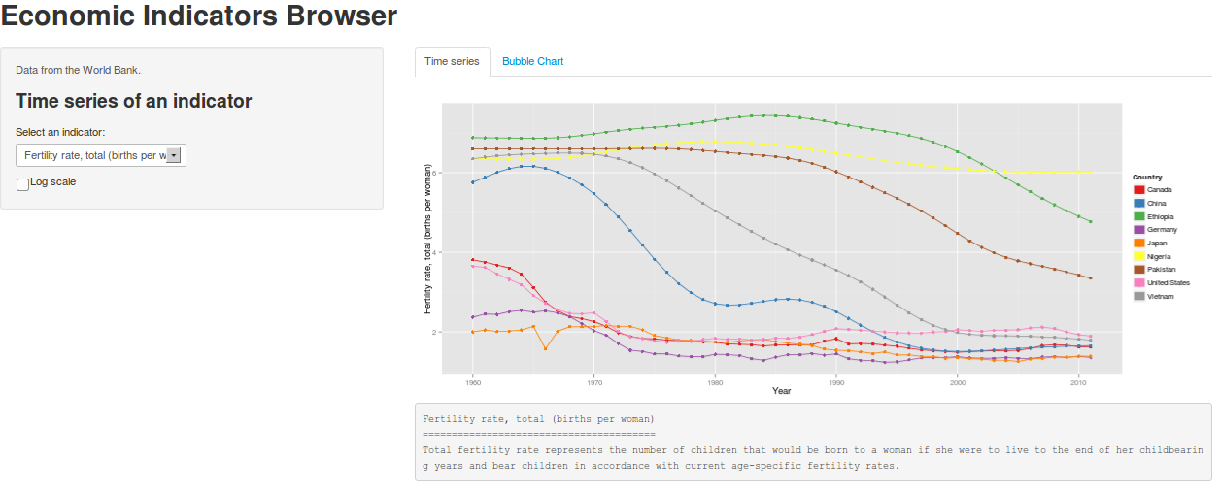
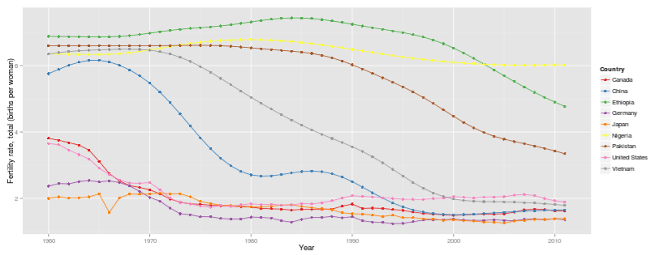
In this video we took a look at
what our dashboard will look like.
how it works.
Next: building the time series plot

Slide 3
In this section we’re going to take a look at
Designing the dashboard
Building the time course plot
Making a bubble chart in ggplot2
Making conditional panels
Building our dashboard

